Slide 1
Introduction to Health Technology Assessment (HTA)
Module: Economic Evaluation for Universal Health Coverage (PPH7039F)
Buhle Ndweni
Health Economics Unit & Division
School of Public Health

Slide 2
HTA definition by WHO
Safety, effectiveness, costs = studied long before HTA
1960-70s increasing technology across society, “Technology Assessment” systematized → intended & unintended (harmful) consequences
1973 est. Office of Technology Assessment (OTA in U.S.A.)
1976 est. OTA health program → social, ethical, legal, political concerns (in vitro fertilization, organ transplants, artificial organs…)
1980s first public HTA agencies supporting governments Europe, Canada
INAHTA est.1993 with 11 member agencies, now 52 in 33 countries
For more information:
Banta, D. (2003). The development of health technology assessment. Health policy, 63(2), 121-132.
https://www.sciencedirect.com/science/article/abs/pii/S0168851002000593
Goodman, CS (2004) HTA 101: Introduction to Health Technology Assessment. The Lewin Group.
https://www.inahta.org/wp-content/uploads/2014/09/HTA-101_Goodman_2004.pdf

Slide 3
HTA definition by WHO
World Health Organization (WHO) defines HTA as:
“The systematic evaluation of properties, effects and/or impacts of health technologies and interventions. It covers both the direct, intended consequences of technologies and interventions and their indirect, unintended consequences. The approach is used to inform policy and decision-making in health care, especially on how best to allocate limited funds to health interventions and technologies. The assessment is conducted by interdisciplinary groups using explicit analytical frameworks, drawing on clinical, epidemiological, health economic and other information and methodologies. It may be applied to interventions, such as including a new medicine into a reimbursement scheme, rolling-out broad public health programmes (such as immunization or screening for cancer), priority setting in health care, identifying health interventions that produce the greatest health gain and offer value for money, setting prices for medicines and other technologies based on their cost-effectiveness, and formulating clinical guidelines.” (in WHO, 2021: p. 4)

Slide 4
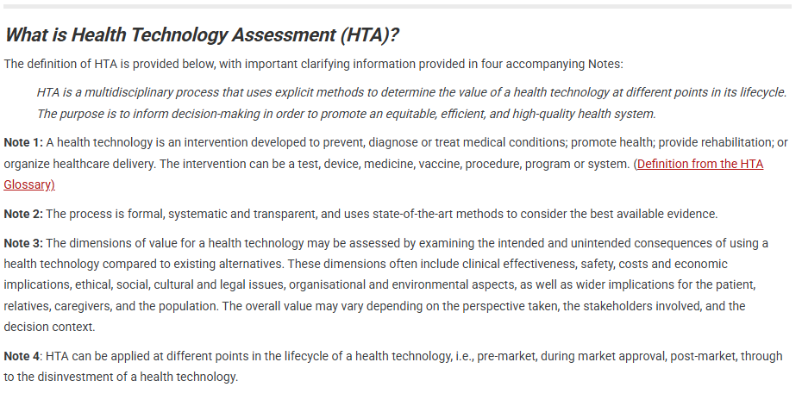
New HTA definition
Notes:
Distribution of facilities and hospital beds
HMI analysis focused primarily on general acute facilities as they account
for the largest share of the market based on the
number of beds, admissions and expenditure.
There are 405 public facilities reporting to
provincial and local government authorities.
Public healthcare facilities serve approximately
83% of the population who are largely without
medical insurance.176 In contrast, there are 409
private facilities distributed across all provinces,
which predominantly serve those insured through
medical schemes.
16,4% of South Africans had medical insurance,
essential for accessing private healthcare

Slide 5
HTA definition
HTA
Build UHC
Maintain UHC
Notes:
HTA for “Prioritization” (WHO literature & LMICs)
HTA for managing new HT pipeline, balancing budgets to maintain UHC “sustainability”

Slide 6
HTA in the health system
Technology development
Under controlled conditions and compared to placebo:
Is the technology safe?
Does the technology do more good than harm?
Regulatory approval
In routine clinical practice and compared with existing treatments:
Do the additional clinical benefits justify the expected additional cost?
HTA
Use in
healthcare system
Incorporating the consideration of social value judgements

Slide 7
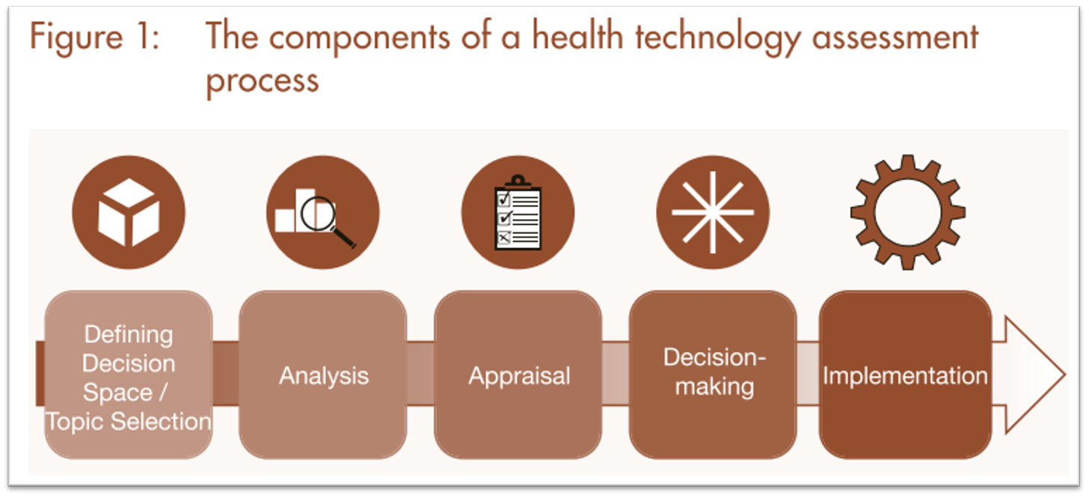
Steps used in HTA
Siegfried N, Wilkinson T, Hofman K. Where from and where to for health technology assessment in South Africa? A legal and policy landscape analysis Where from and where to for health technology assessment in South Africa? A legal and policy landscape analysis. 2017;41–8. Available from: http://www.hst.org.za/publications/South African Health Reviews/4_Where from and where to for health technology assessment in South Africa.pdf
Notes:
Table 1: All countries required 1–3 years to design their packages.
The timeline was important as it ensured:
Adoption of DCP3 guiding principles
Effective partnerships are secured
Baseline assessments are effectively conducted
Sound and reliable processes for prioritisation and costing.
The Pakistan and Sudan packages were developed for the first time
The other four countries already had existing health benefits packages before the endorsement of the SDG target 3.8 in 2015.

Slide 8
Steps used in HTA
Topic selection:
Clearly incredibly important
Overwhelmingly large number of potential new technologies; more so if developing Health Benefits Package for universal health coverage (UHC) [e.g. health service coverage, proportions of services covered etc in the National Health Insurance (NHI)]
Analysis:
Systematic review of effectiveness
Economic evaluation (e.g. CCA/CEA/CUA plus BIA)
Appraisal:
Structured consideration of the evidence; usually lead by a committee that includes wide range of stakeholders
Decision-making:
Undertaken by the body signing off on the decision; can include other social value judgements not fully captured within appraisal
Implementation:
Broader health system processes beyond the remit of the HTA agency/process
Notes:
CCA = cost-consequence analysis
The various institutions are fragmented and work in silos.

